Slide 1
Privacy-Preserving Ridge Regression with only linearly-homomorphic Encryption
BASED ON A paper By Irene Giacomelli, Somesh Jha, Marc Joye,
C. David Page, and Kyonghwan Yoon
PUBLISHED IN B. Preneel and F. Vercauteren , IN 2018
Notes:
All the pictures have been found in the power point image search engine
1

Slide 2



OUTLINE
BASIC DEFINITIONS
Threat Model and System Overview
2 – Server Model
Protocols description
Communication complexity
Implementation

Slide 3

BASIC DEFINITIONS
Linear Regression
Ridge Regression
Cryptographic tools

Slide 4
BASIC DEFINITIONS
Linear Regression is an important statistical tool that models the relationship between some explanatory values (features) and an outcome value using a linear function.
Ridge regression is one of the most widely-used forms of regression. It lessens the over-fitting of ordinary least squares regression without adding computational cost.
Notes:
4

Slide 5
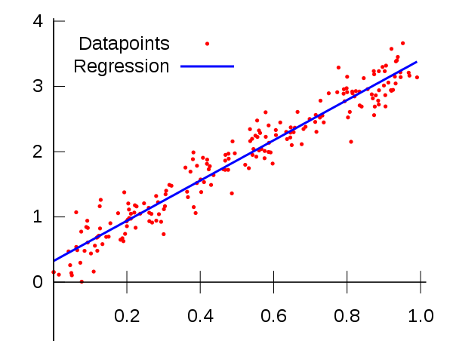
Linear Regression
Linear regression is a linear model, e.g. a model that assumes a linear relationship between the input variables (x) and the single output variable (y). More specifically, that y can be calculated from a linear combination of the input variables (x).
The aim of regression analysis is to explain Y in terms of X.
A linear regression learning algorithm is a procedure that:
on input: n points {(x1,y1),.....,(xn,yn)} where x ∈ R^d and y ∈ R.
outputs: w ∈ R^d vector
Scoring: y ≈ fw(x)
we have that w* is computed solving the linear system:
Aw=b
Notes:
5

Slide 6
in some applications these values represent a sensitive data (such as medical data) that we don’t want to share it, in this presentation we will describe how to train a ridge linear regression model using only LHE (Linearly homomorphic encryption) as described in the paper.

Slide 7
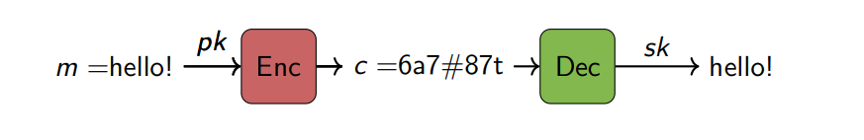
Cryptographic tools
To design our privacy-preserving system, we utilize homomorphic encryption.
Let (M, +) be a finite group, the linearly homomorphic scheme (LHE) for M is defined by three algorithms:
1) The key-generation algorithm Gen: (sk, pk) ← Gen(κ)
2) The encryption algorithm Enc: c ← Encpk (m)
3) The decryption algorithm Dec is a deterministic function that uses the secret key sk to recover the original plaintext from a ciphertext c .
Notes:
7

Slide 8
Threat Model and System Overview
The data owners: There are m data-owners, each data-owner has a private dataset and is willing to share it only if encrypted.
The machine learning engine (MLE): This is the party that wants to run a linear regression algorithm on the dataset D obtained by merging the local datasets(access only to the encrypted copies of the datasets).
The Crypto Service Provider (CSP): takes care of initializing the encryption scheme used in the system and interacts with MLE to help it in achieving its task, it manages the cryptographic keys and is the only entity capable of decrypting.
Notes:
8

Slide 9
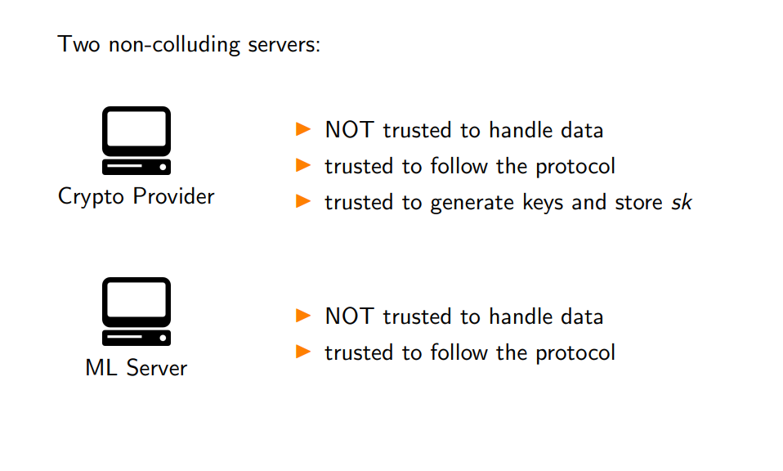
2 – Server Model
Notes:
9

Slide 10

Notes:
10

Slide 11
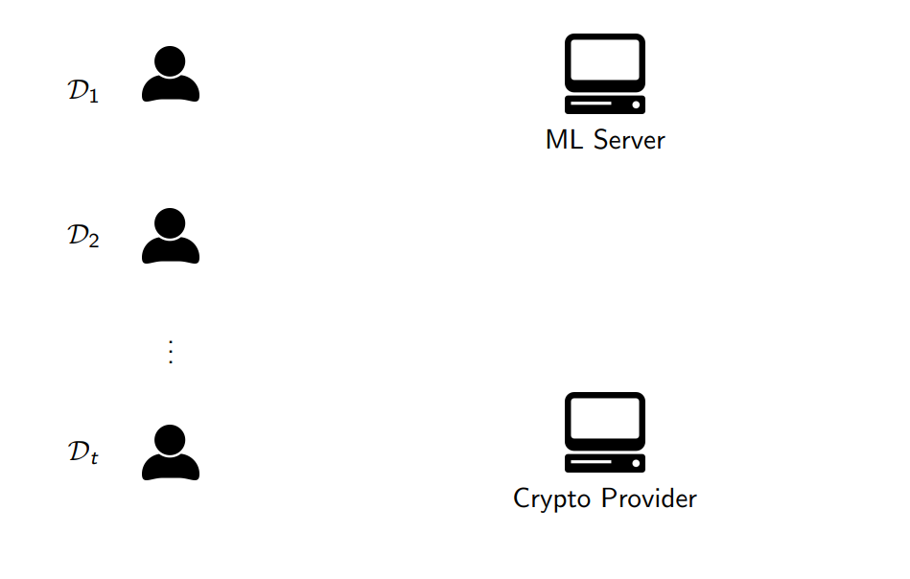
System Overview
The system has the following two-phase architecture:
phase1(Merging the local dataset):
Notes:
11

Slide 12
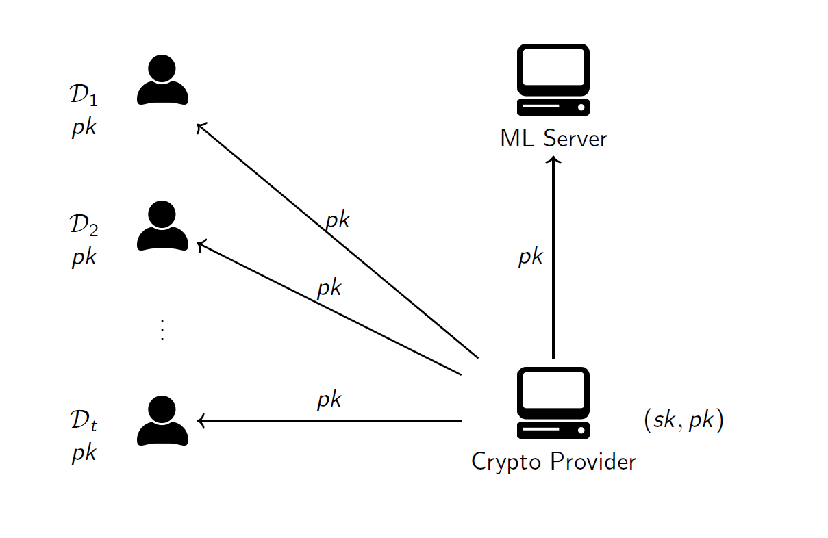
CSP generates the key pair (sk, pk), stores sk and makes pk public
Notes:
12

Slide 13
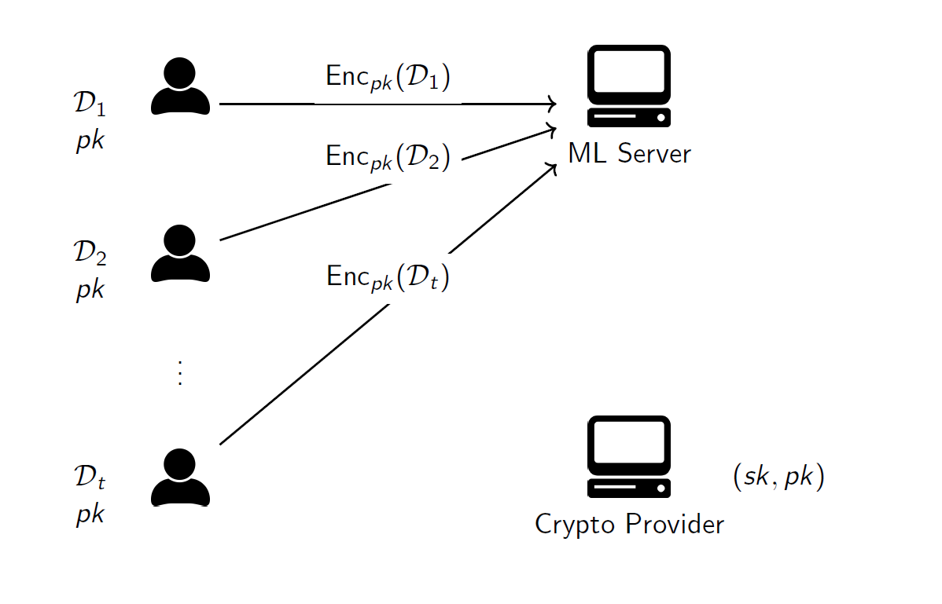
Each DO send to MLE specific ciphertexts computed using Pk and the values in Di
Notes:
13

Slide 14
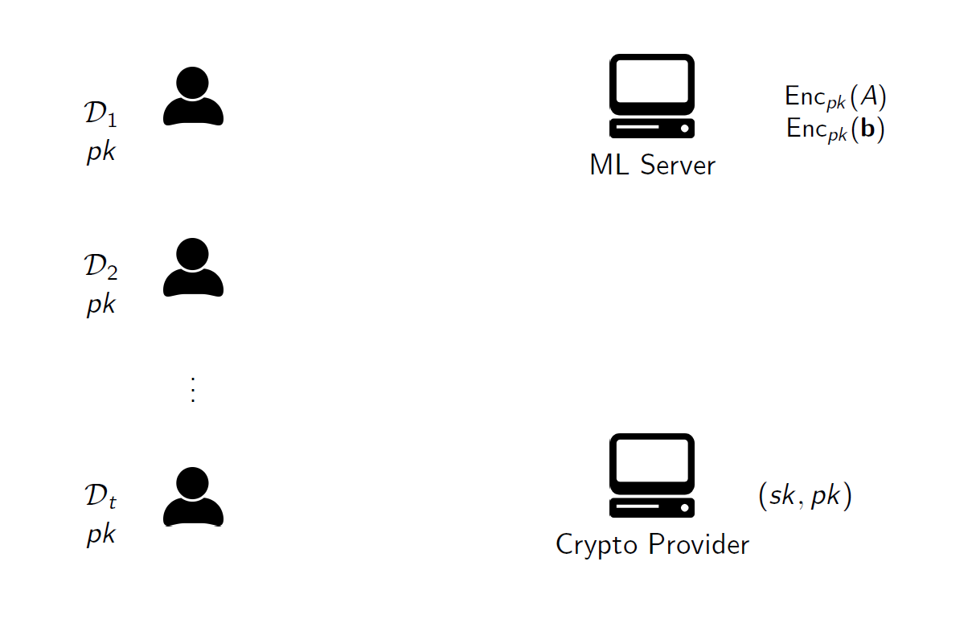
MLE uses the ciphertexts received and the homomorphic property in order to obtain encryptions of A and b (cofficient matrix and vector)
Notes:
14

Slide 15
The encryptions are sent to to the CSP which runs a given algorithm on the masked data
Output: vector w~ that is sent back from CSP to MLE to compute w*
Notes:
15

Slide 16
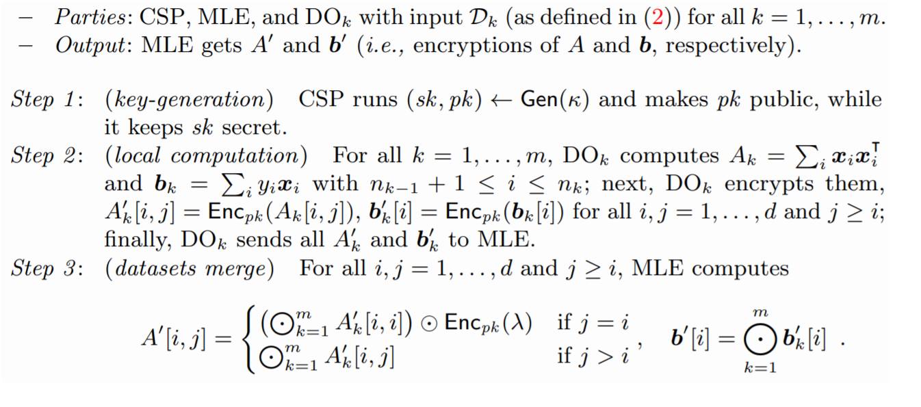
Protocols Description:
Phase 1-Protocol 1 horizontally partitioned setting

Slide 17
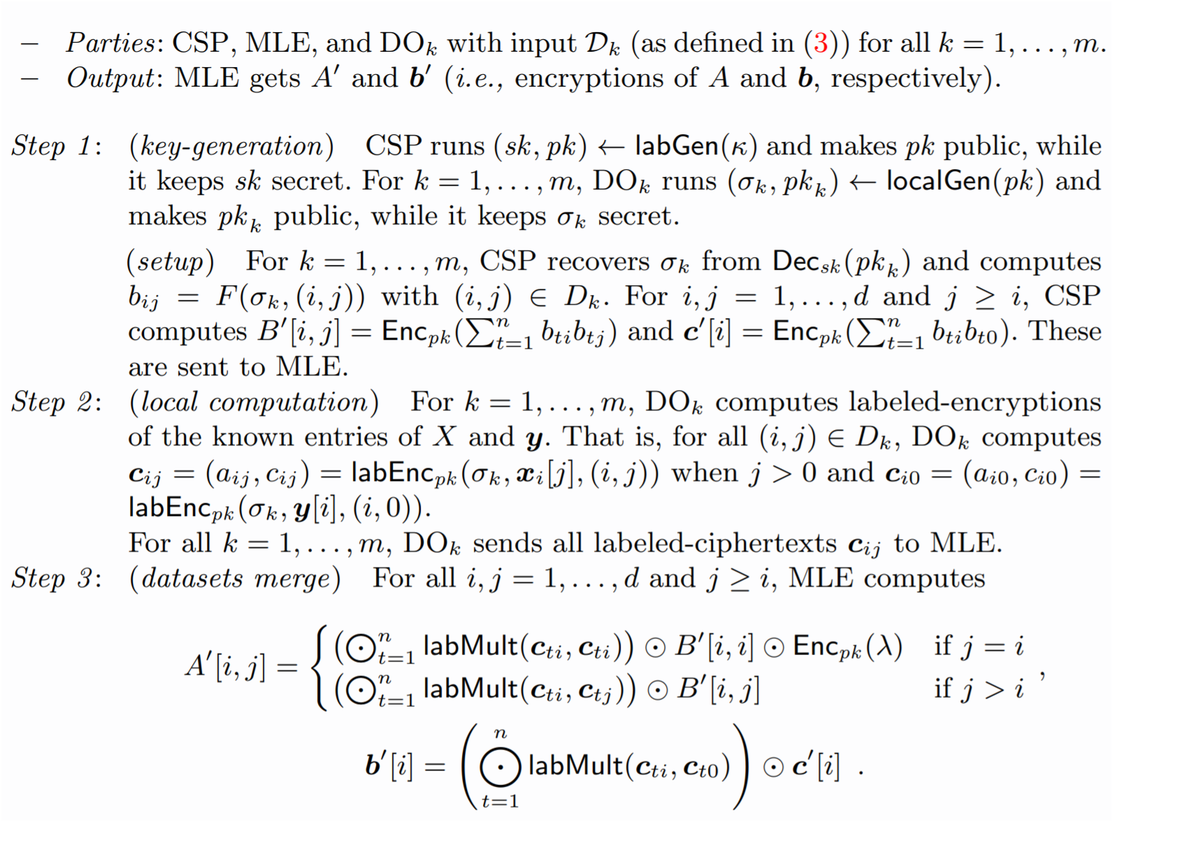
Phase 1-Protocol 2 Arbitrarily partitioned setting

Slide 18
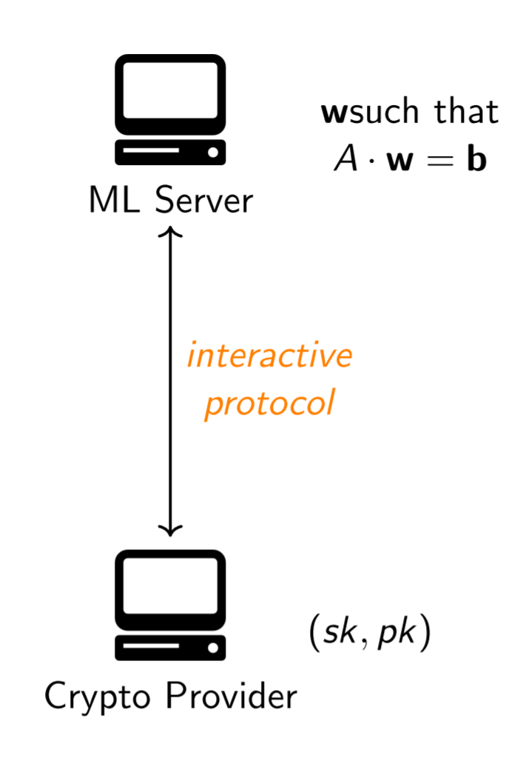
Protocols Description
Phase 2 (Computing the model) :MLE uses the ciphertexts and private random values in order to obtain encryptions of new values that we call “masked data”; these encryptions are sent to the CSP; the latter decrypts and runs a given algorithm on the masked data. The output of this computation is a vector that is sent back from the CSP to the MLE. The latter computes the output w∗ from .
Notes:
18

Slide 19
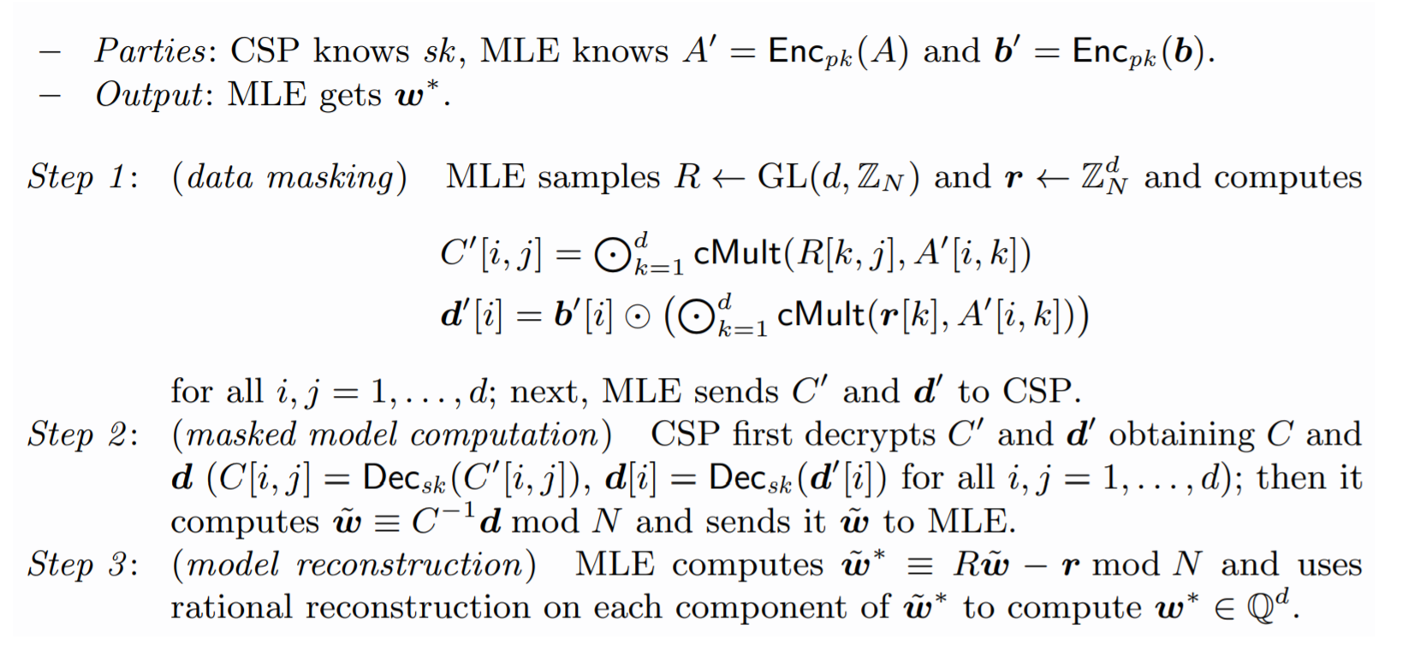
Phase 2 – Protocol 3

Slide 20

THE IMPORTANT QUESTION
what is the Efficiency communication & running Time ?

Slide 21
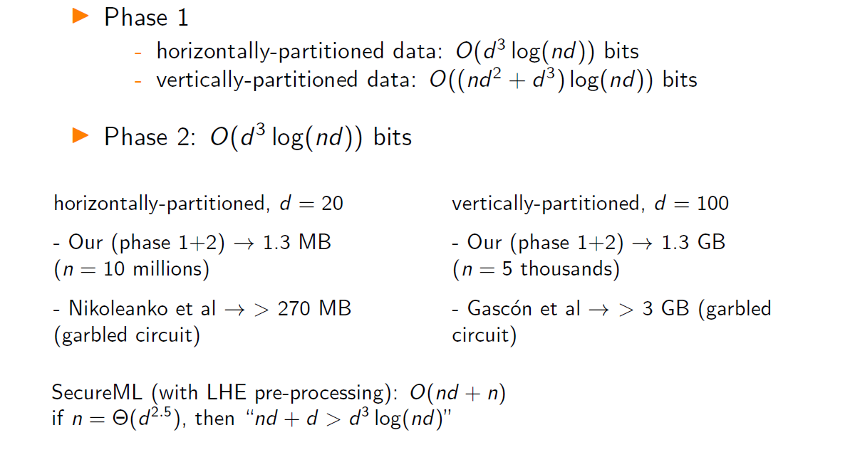
Efficiency : Communication complexity
n data points, d features:
Notes:
21

Slide 22
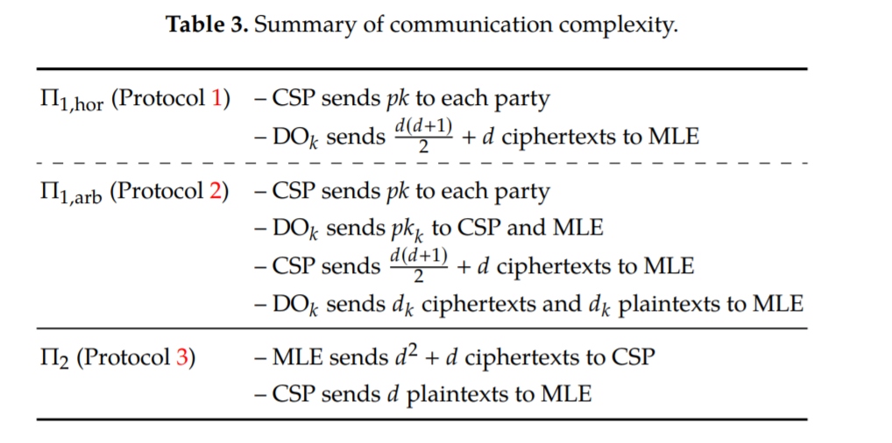

Slide 23
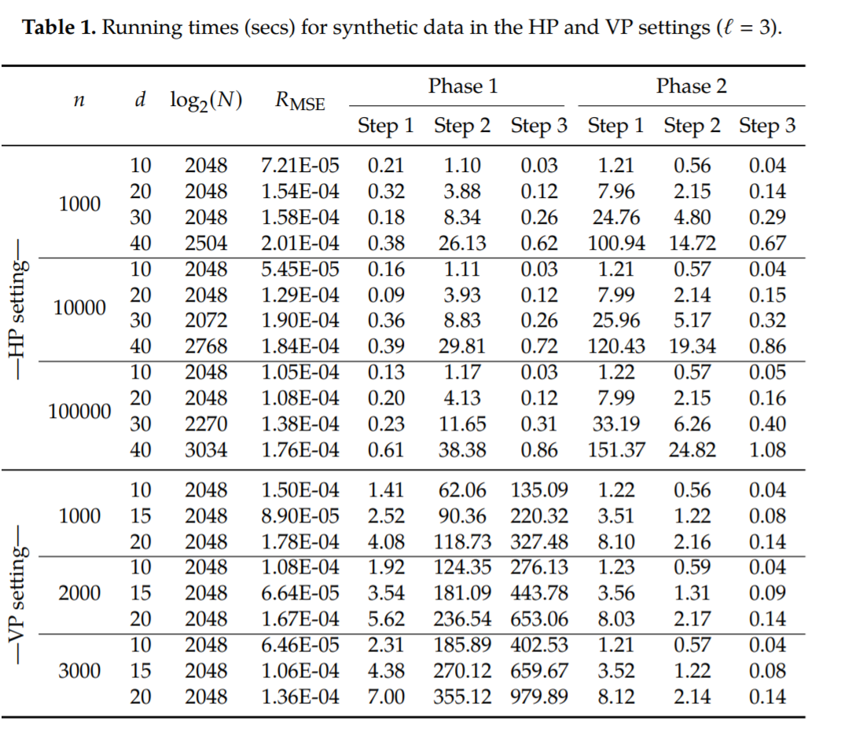
Implementation and running time
Paillier’s scheme – Homomorphic encryption (encryption, decryption and ciphertext operations).
Gaussian elimination for compute determinants and linear systems.
All the timings are reported in seconds, all the values are averaged on 5 repetitions of the same
experiment.

Slide 24
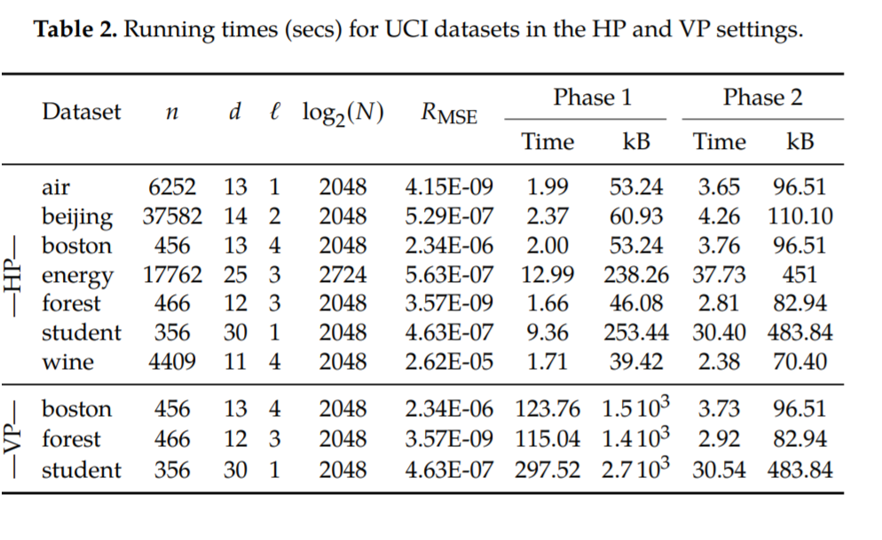
Efficiency : Running Time
Notes:
24

Slide 25
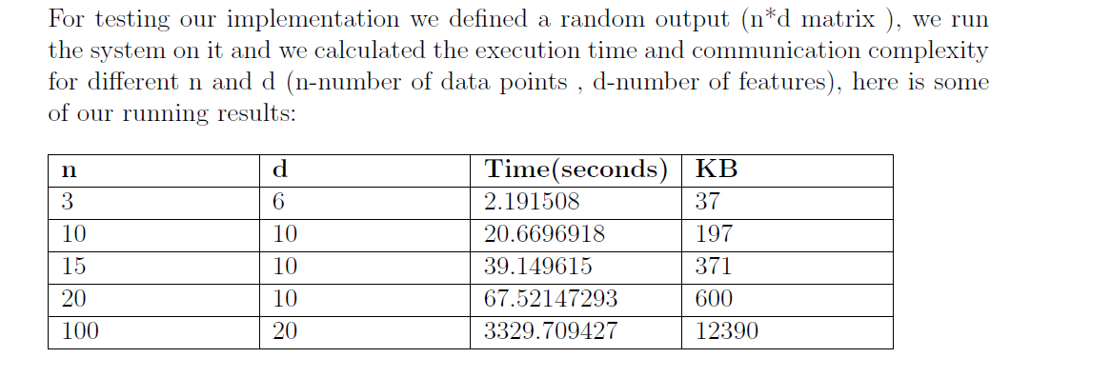
Results for our implementation:

Slide 26


SUMMARY
We described a new system to train a ridge regression model on
the merge of encrypted datasets held by mutually distrustful
parties. The system is designed in the 2-server model and
is the first one based only on LHE.

Slide 27

QUESTIONS?

Slide 28
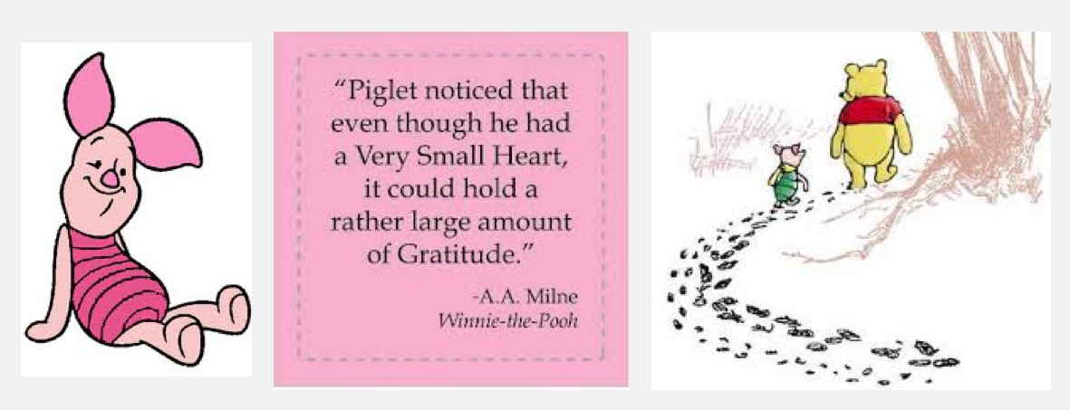
THANK YOU!
This Photo by Unknown Author is licensed under CC BY-NC-ND

